Slide 1




MUZIX
APPLICATION
FULL STACK SOFTWARE DEVLOPMENT
1

Slide 2



Our Team Members-
Utkarsh Chaudhary
Rishita Saha
Shivansh Bohra
2

Slide 3





INTRODUCTION
Our Major Project is Muzix Application.
Registered user can make multiple profiles.
Facility to search movies as per the requirement.
Used 3rd party API to fetch movies.
This is a responsive website.
3

Slide 4



BENEFITS
Convenience:- Our Muzix application offers the convenience of being able to watch movies anytime, anywhere with an internet connection.
Time Efficient:- It gives one platform to browse through all movies and choose any by personalized criteria and watch them.
Flexibility: Movie websites offer the flexibility to watch movies on different devices and at your own pace.
Customize Playlist: Add any movie you want to watch later or rewatch to your favorite list.
4

Slide 5
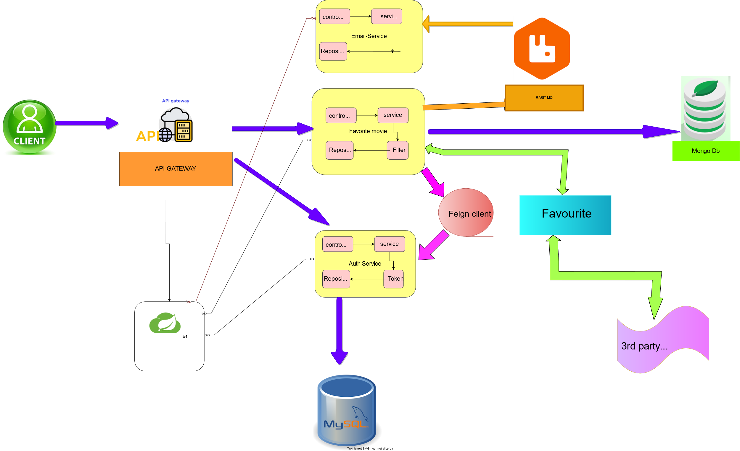

ARCHITECTURE BACKEND
Rabbit Mq
Client
discovery
discovery
discovery
discovery
TMDB
Eureka
5

Slide 6
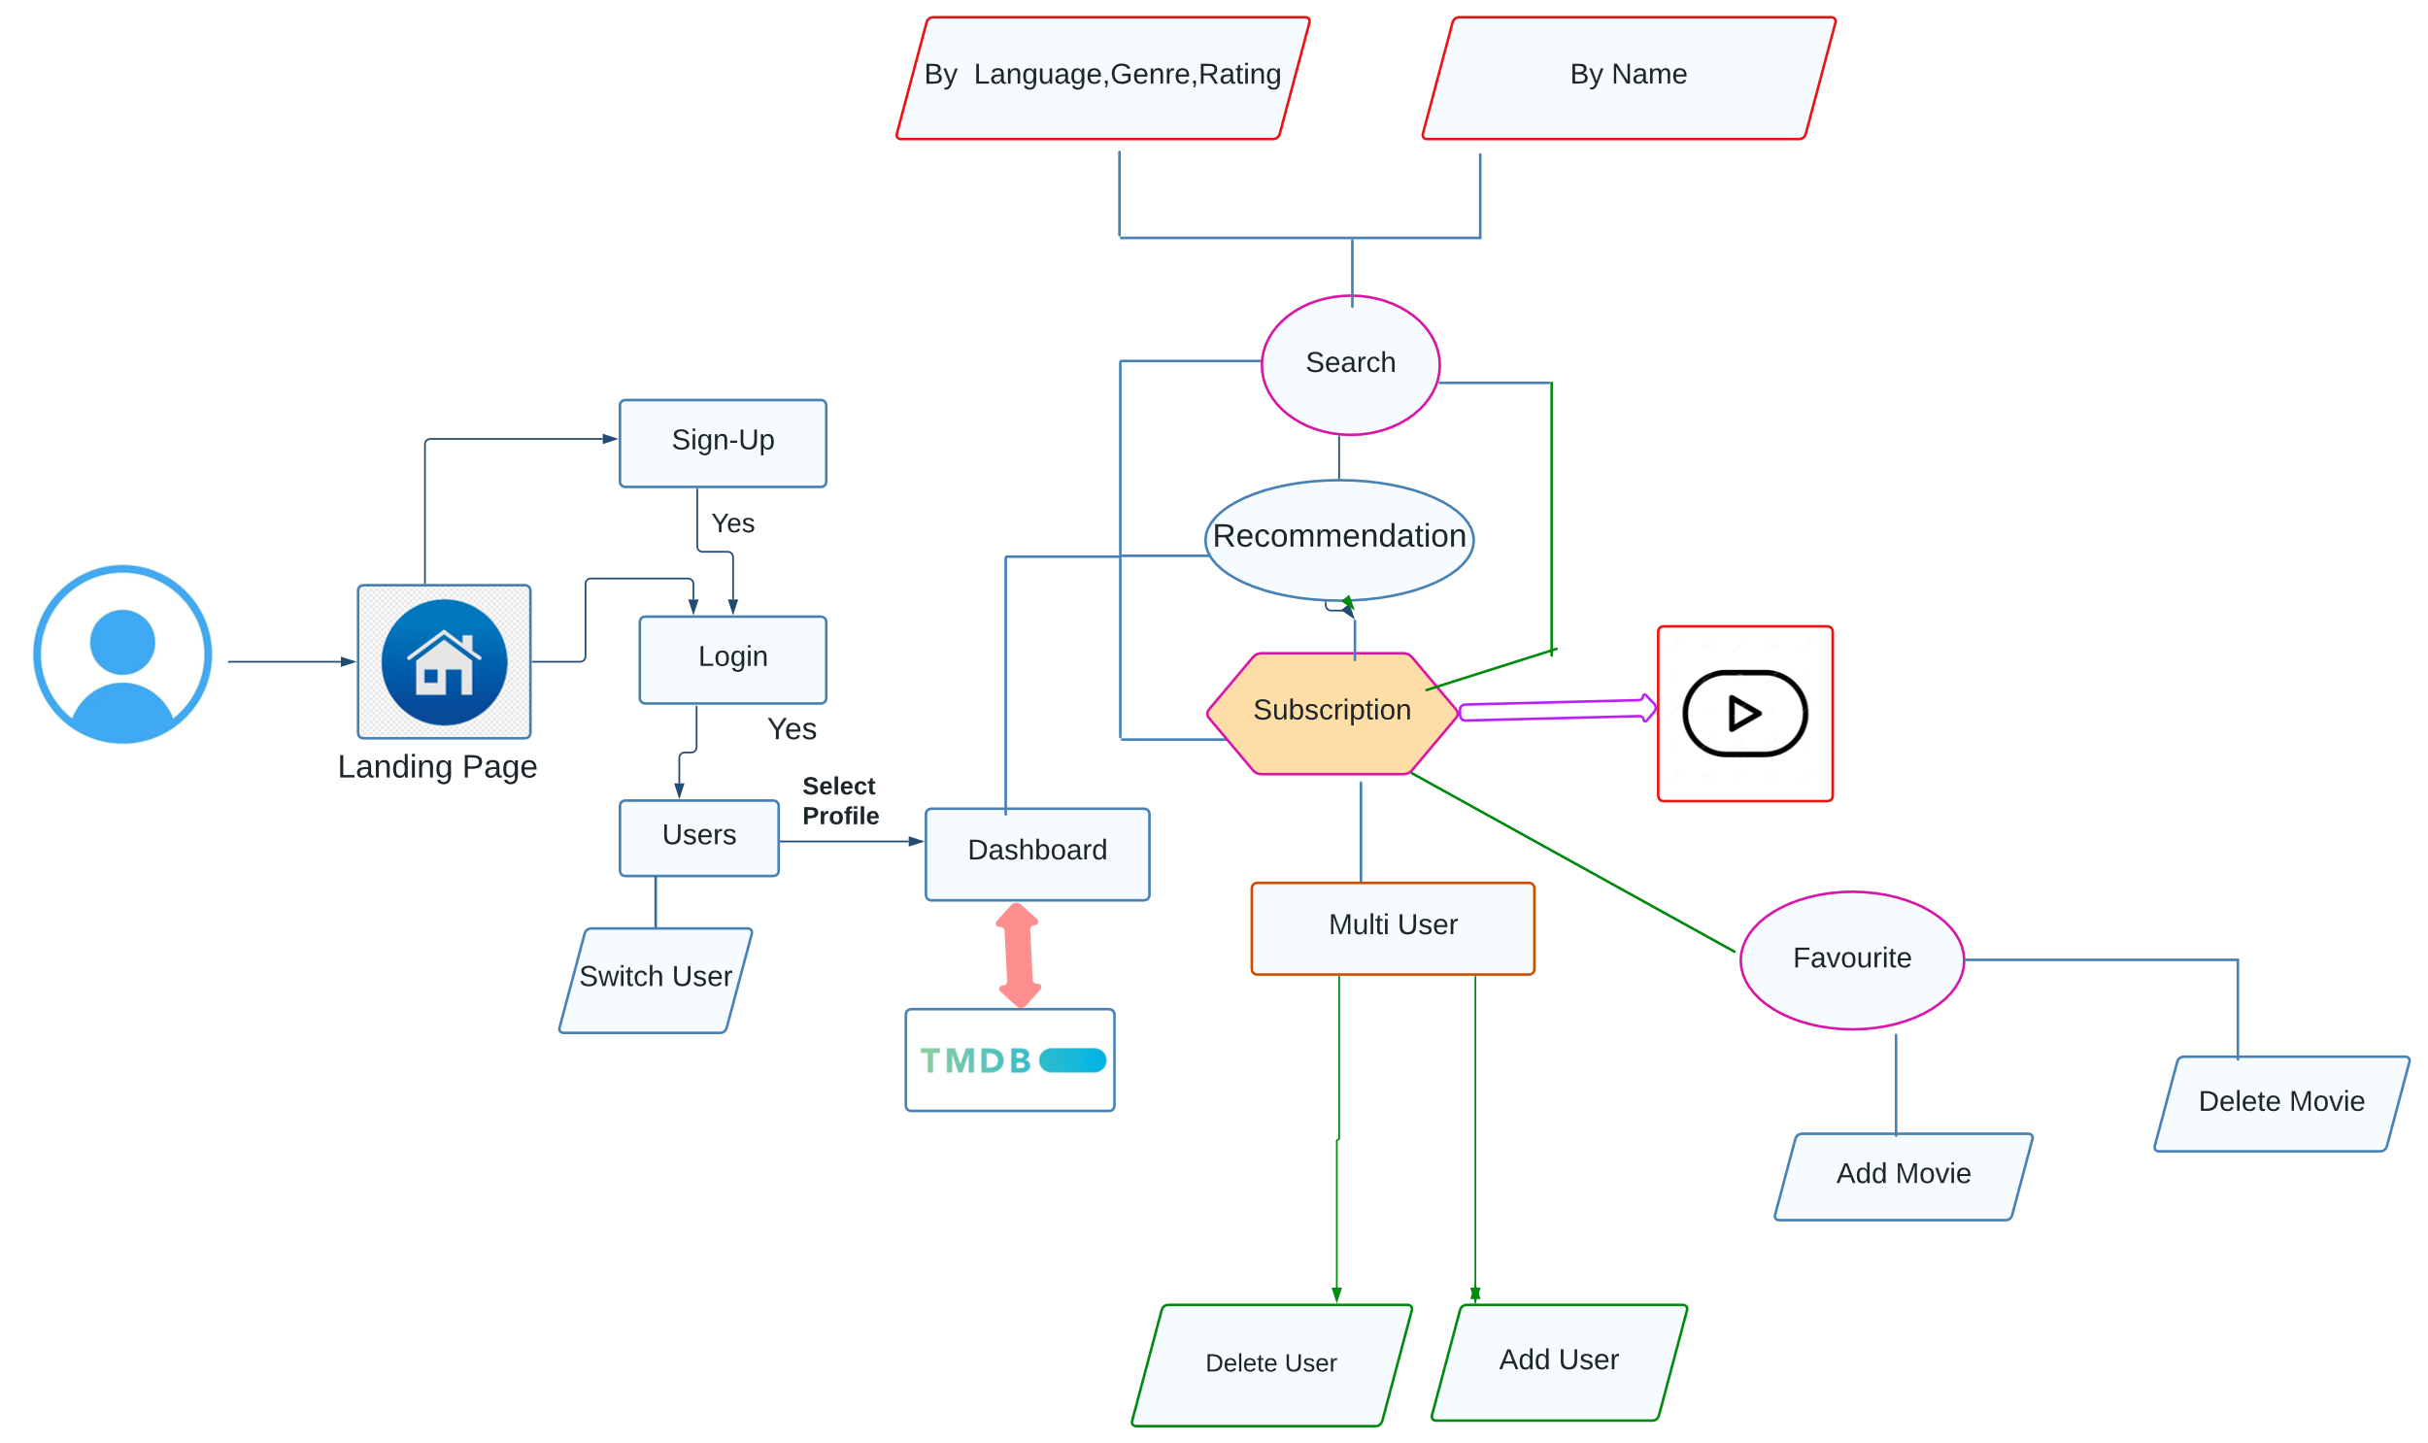
FLOW DIAGRAM OF FRONTEND
User
6

Slide 7


TOOLS & TECHNOLOGIES
Database
2. Mongo Db
1.MySql
7

Slide 8





TOOLS & TECHNOLOGIES
Backend
1. Spring Boot
2. Eureka Server
3. API Gateway
4.Feign Client
5.Java
6.Rabbit MQ
7. JWT Token
8

Slide 9
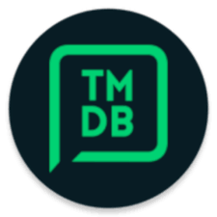



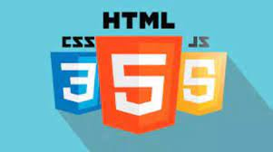
TOOLS & TECHNOLOGIES
Frontend
Angular
2. Type Script
3. Boot Strap
4.HTML,CSS,JS
5.TMDB
6.Angular-Material
9

Slide 10
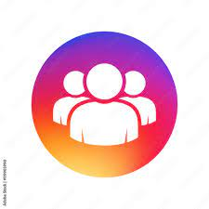



FEATURES
Multiple Profile
Successfully verified registered users can have multiple profiles.
Browse
Browse movie information and enjoy any movie trailer.
Search
Search Movies- Can search movies on rating, language, genre, and name basis.
Add and delete
Users can add and delete any movie from their customized favorite list.
Get Recommendation
Get Recommended movies on basis of your searched movies.
10

Slide 11
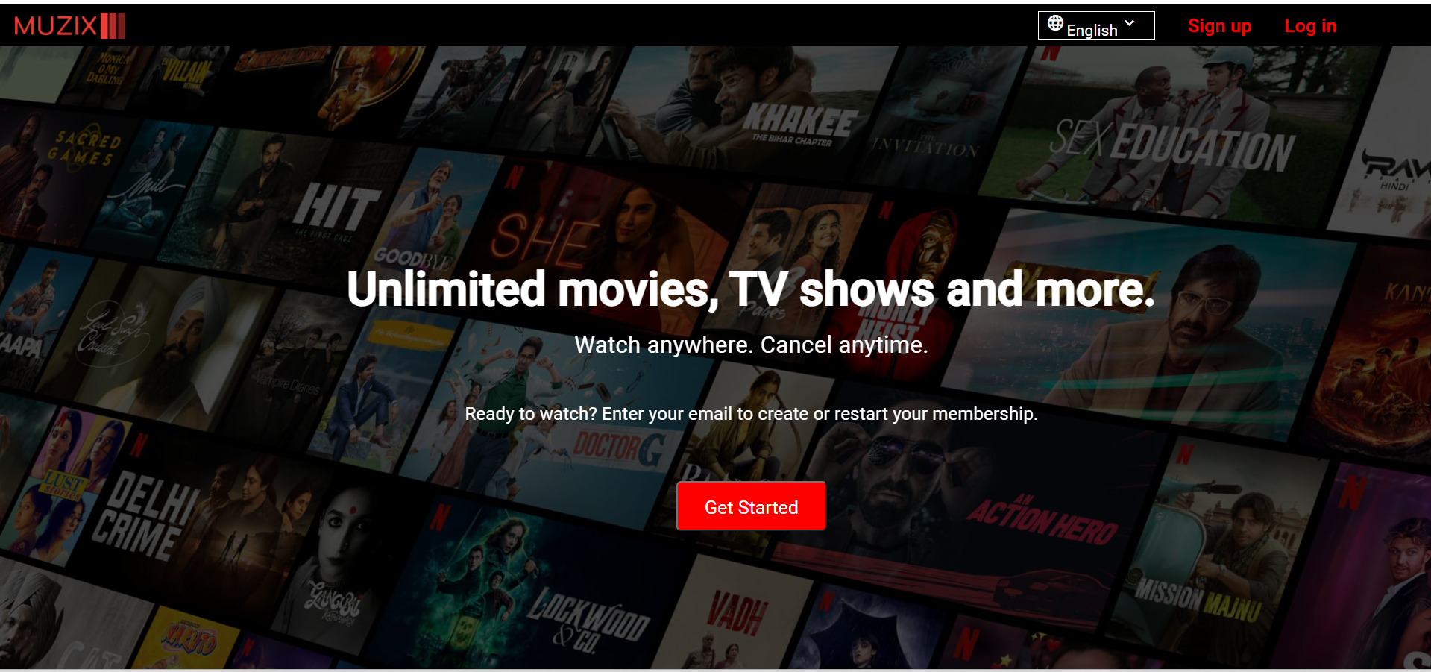
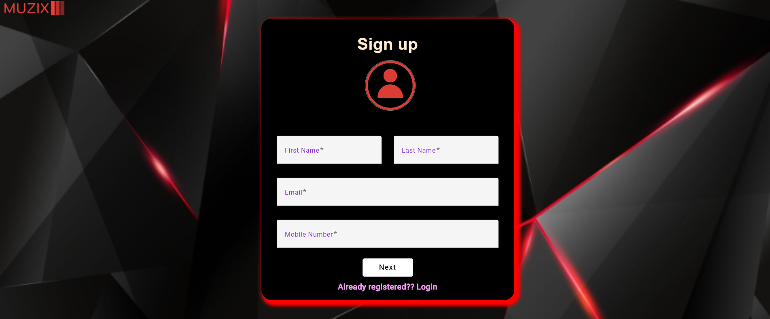
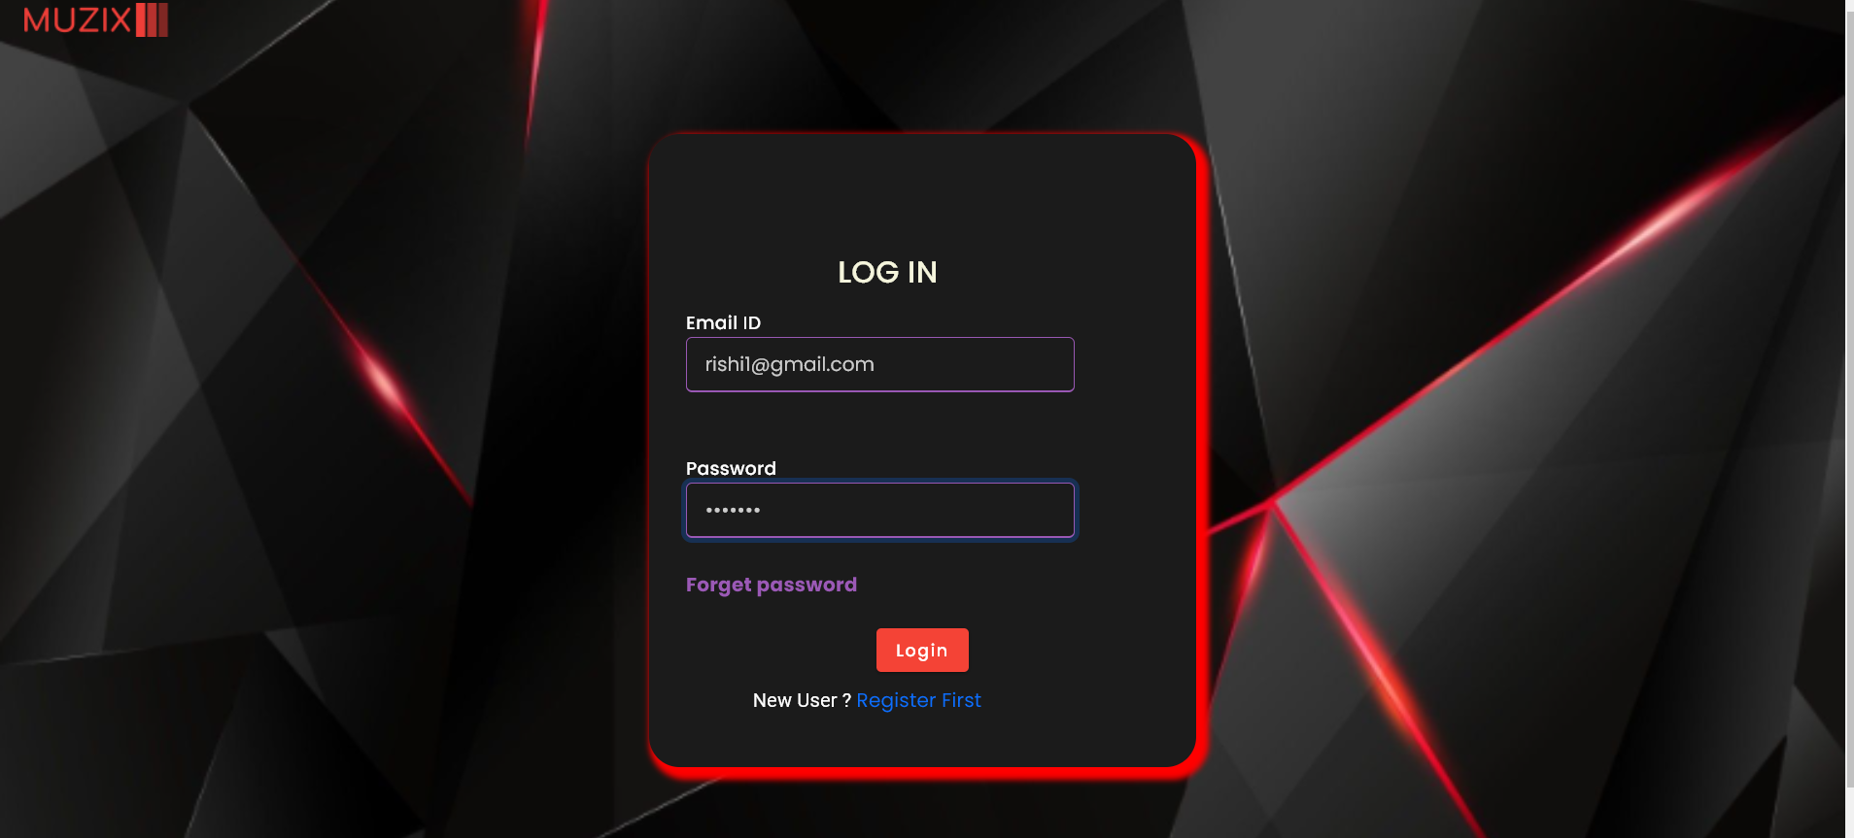
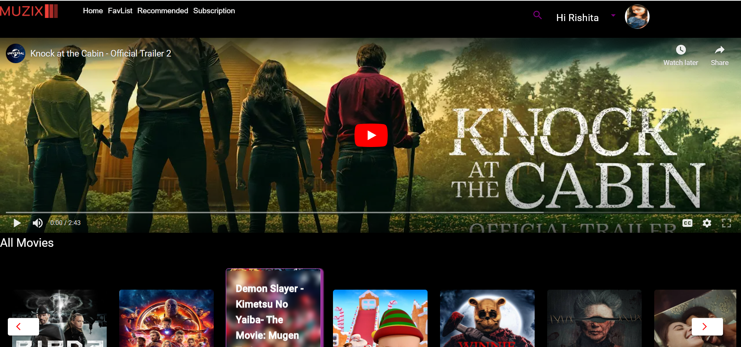
INTERACTIVE DEMO
Landing Page
Sign up
Landing Page
Signup Portal
Login
Login Portal
Dashboard
11

Slide 12
Questions And Answers
12

Slide 13

FUTURE ENHANCEMENT
We would like to make our project multilingual, so it can be browsed with any language.
Update user will be implemented.
Live broadcasts like sports, and news.
Make personalized
advertising.
Make notification of your watchlist so that a client can get notification about what movie they haven’t watched yet.
CAN DIRECTLY REGISTER WITH GOOGLE ACCOUNT
13

Slide 14
Thank You
14

